Slide 1
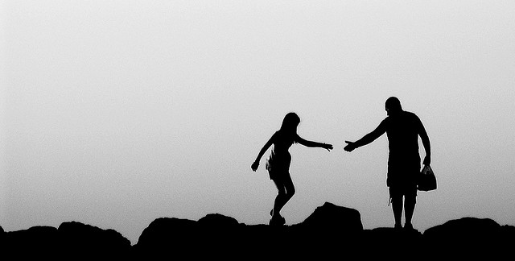

Helping and Prosocial Behavior
[Professor Name]
[Class and Section Number]
Notes:
Classroom Recommendations: This material could be covered in one 50-75 minute class period. If it is a 50-minute class period, some of the discussions will need to be time limited. If you have students who like to discuss a lot, then this could be stretched into 1 1/2 class periods.
Overview: Prosocial behavior includes activities such as helping, donating, cooperating, and sharing. Students will be interested in why people help in emergency situations, and they will be even more fascinated by why people don’t help. The information in this module covers some of the basic issues, such as when people are more or less likely to help, who is more likely to help, and why people help. This instructor’s manual includes discussion questions and activities to help engage your students in the material, and it includes links to other resources that may help you design a great portion of your course.
Technical Note: These slides may contain simple click animation so that you can focus students’ attention on a particular question, a selection of text, or an image and not have them be distracted by reading ahead. You can either preview the sequence of animation by going through the slides in slideshow view, visiting the animations tab, or reviewing the slide notes. In the notes you will see a cue - (Click) – that corresponds to each animation.
You will also find hyperlinks to outside videos at various places in the slides. These hyperlinks are embedded in text and indicated by color and in the notes section.

Slide 2
Today’s Learning Objectives
Learn which situational and social factors affect when a bystander will help another in need.
Understand which personality and individual difference factors make some people more likely to help than others.
Discover whether we help others out of a sense of altruistic concern for the victim, for more self-centered and egoistic motives, or both.
Notes:
The purpose of this slide is to provide students with an overview of the learning objectives for this module.

Slide 3
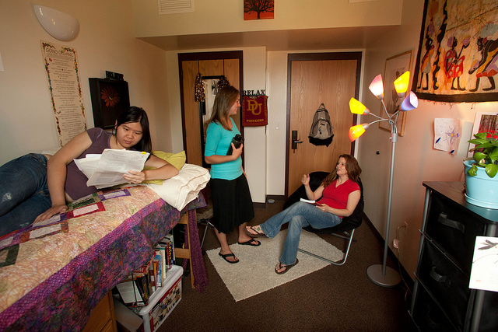
Warm Up: Would You Help?
How likely are you to help?
What are the costs? What are the rewards?
Notes:
This slide introduces the concept of costs and rewards with an optional activity.
Warm up activity: The rewards/costs activity in the IM – Activities and Demonstrations, based on the following scenario:
One evening, just as you settle down to study for an important test, an acquaintance from down the hall in your dormitory enters your room. He/she asks for assistance with some homework which is due the next morning. It turns out that you have already taken the same course in which your acquaintance needs help.
(Click) How likely are you to help?
(Click) What are the costs? What are the rewards?
Explanation:
People utilize a cost-benefit analysis before deciding to help or not. What are the costs? Do they outweigh the benefits? If so, helping is less likely. However, if the benefits outweigh the costs, the likelihood of helping increases. The benefits of helping can include the social rewards people receive or the guilt people avoid when they help.
The overall goal is to get students thinking about how we weigh costs and rewards when we are deciding to help. You can ask more probing questions, which get at costs and rewards. For example, you could ask, “If you were studying for a very tough final for a class where you had to do well to graduate and this was your only time to study, would this change your decision?” or “If you thought you could do well on the exam without studying much and you still had time to study, even if you helped this person, would you be more or less likely to help?”
Based on:
Kerber, K. W. (1980). Rewards, costs, and helping: A demonstration of the complementary nature of experimental and correlational research. Teaching of Psychology, 7(1), 50-52. doi:10.1207/s15328023top0701_14

Slide 4
Overview
Introduction
When do People Help?
Who Helps?
Why Help?
Conclusion
Notes:
The purpose of this slide is for the instructor to provide students with an overview of the material that will be covered during the lecture.

Slide 5
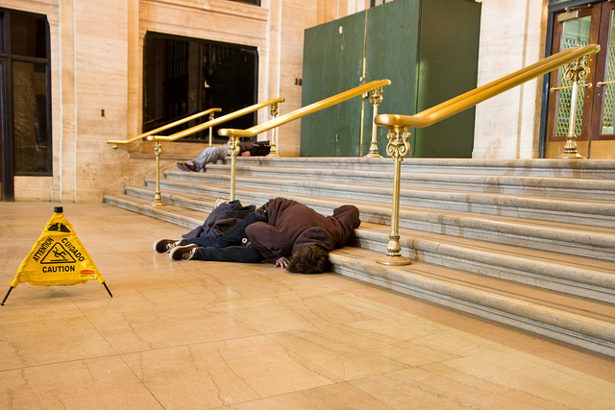
Introduction
Would you offer to help in this situation?
What are some obstacles to providing help?
Notes:
The purpose of this slide is to introduce the topic of helping and prosocial behavior.
(Click) Would you offer to help in this situation?
(Click): What are some obstacles to providing help?
These are discussion questions which will help start the discussion of helping and prosocial behavior. Students’ responses may be influenced by the ambiguity of the situation, given that it is not clear what is happening in the picture. It may also be influenced by the potential danger perceived in the situation. You can also further the discussion by asking, “What if a lot of other people were around, and they were ignoring the situation?”
Optional Activity:
Get students into small groups. Have them discuss the obstacles to providing help. After they have identified the obstacles, have them discuss how to overcome the obstacles. The activity will help them identify how tough it is to actually help in a real-life situation, as well as create solutions to the problems. This activity is a version of the Knotty Problem cooperative learning activity (see http://teachingcommons.depaul.edu/Classroom_Activities/collaborative/activities.html for more info).

Slide 6
Overview
Introduction
When do People Help?
  Pluralistic Ignorance
  Diffusion of Responsibility
  Costs and Rewards
Who Helps?
Why Help?
Conclusion
Notes:
This slide explains the upcoming topic and orients the students.

Slide 7
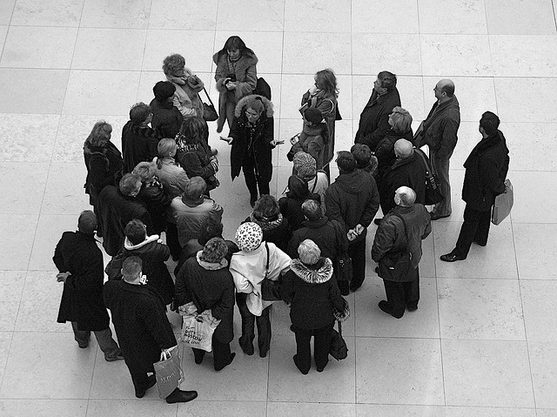
When Do People Help?
Pluralistic Ignorance
Less likely to help
If you need help, how do you counteract pluralistic ignorance?
Notes:
This slide introduces the concept, pluralistic ignorance.
(Click): Pluralistic Ignorance
Pluralistic ignorance is relying on other bystanders to determine if help is needed. This is when no one else does anything, so a bystander also does nothing.
(Click) Less likely to help
This emphasizes that when pluralistic ignorance occurs, helping does not happen.
(Click) If you need help, how do you counteract pluralistic ignorance?
Explanation: Pluralistic ignorance is more likely to happen in ambiguous situations. So, anyone who needs help should reduce ambiguity by making it clear help is needed by directly asking for help.

Slide 8
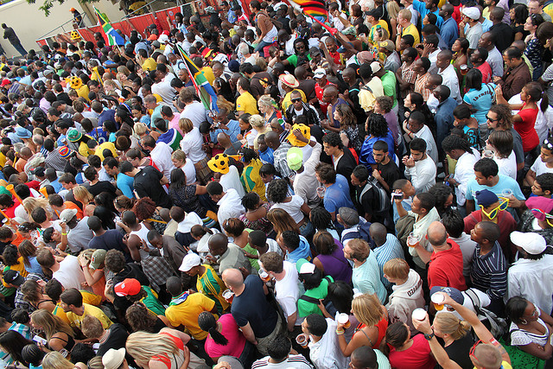
When do People Help?
Diffusion of Responsibility
Less likely to help
If you need help, how do you counteract diffusion of responsibility?
Notes:
This slide introduces the concept of diffusion of responsibility.
(Click): Diffusion of responsibility is taking less responsibility for a situation when more people are around. When you are the only one to see an emergency, then the responsibility is all yours, in terms of helping. However, if many people see an emergency, then the responsibility is spread out among those people.
(Click) Less likely to help
This emphasizes that when diffusion of responsibility occurs, helping does not happen.
(Click) If you need help, how do you counteract diffusion of responsibility?
Explanation: Diffusion of responsibility can be taken away by asking a specific person for help. For example, find a distinguishing characteristic – “You, in the red shirt” – and ask for something specific, such as “Call 911!” This can stop the diffusion of responsibility.
Based on the research, this advice is in the training manuals for the American Heart Association’s CPR and other emergency trainings. Depending on whether their instructors used this information, your students may remember it from CPR training.

Slide 9
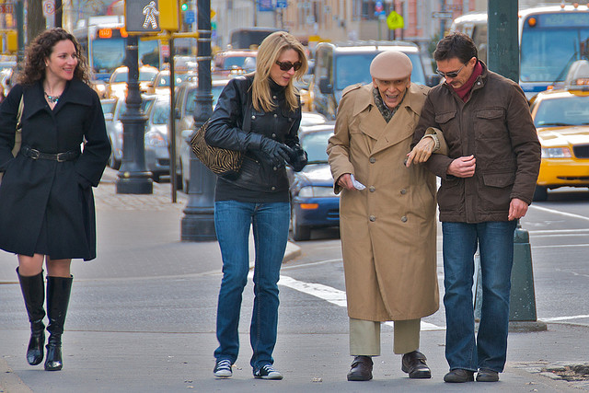
When do People Help?
Costs and rewards
Notes:
This slide highlights the concept of costs and rewards.
(Click): Costs and Rewards
People utilize a cost-benefit analysis before deciding to help or not. What are the costs? Do they outweigh the benefits? If so, helping is less likely. However, if the benefits outweigh the costs, the likelihood of helping increases. The benefits of helping can include the social rewards people receive or the guilt people avoid when they help.
If you did the warm up activity on Slide 3 of this PowerPoint (and in the IM under Activities/Demonstrations) then you can reference it again here.

Slide 10
Overview
Introduction
When do People Help?
Who Helps?
  Men or Women?
  Agreeableness
  Prosocial Personality
Why Help?
Conclusion
Notes:
This slide explains the upcoming topic and orients the students.

Slide 11
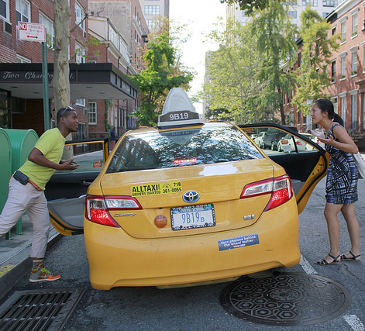
Who Helps?
Men or women?
No difference overall
Dangerous situations?
Men more likely to help
Why?
Cost-benefit analysis
Socialization
Notes:
This slide begins the discussion of who helps by discussing gender.
(Click) Men or women?
If you ask students what they think at this point, you will likely get answers based on gender stereotypes. This can be helpful, if you have the time to thoughtfully connect their answers to stereotypes and gendered socialization.
(Click) No difference overall
Overall, there is not a difference in whether men or women are more helpful.
(Click) Dangerous situations?
If you ask students who is more likely to help (men or women) in dangerous situations, you will likely get the correct answer. Asking them why they thought it was the answer can yield further discussion, leading to the next ‘why?’ question.
(Click) Men more likely to help
A gender difference does emerge when considering the type of helping involved. Men are more likely to help in potentially dangerous situations, and women are more likely to help when there is no danger.
(Click) Why?
Why are men more likely to help in dangerous situations and women more likely to help in other situations?
(Click) Cost-benefit analysis
A cost-benefit analysis could explain this finding, as the dangerous situation may simply be more risky for women.
(Click) Socialization
Socialization and gender roles could also help explain this phenomenon, where men would be more likely to help in risky situation and women would be more likely to be caring and supportive in personal relationships.
Discussion Question:
Do you think that sex and gender differences in the frequency of helping and the kinds of helping have changed over time? Why? Do you think that we might expect more changes in the future?

Slide 12

Who Helps?
Agreeableness
Notes:
This slide introduces the concept of agreeableness .
(Click): Agreeableness
One of the Big Five personality factors, agreeableness, is related to helping. People who score high on agreeableness are more likely to be kind, considerate, warm, and sympathetic. They are also more likely, compared to those who score low on agreeableness, to help others.

Slide 13
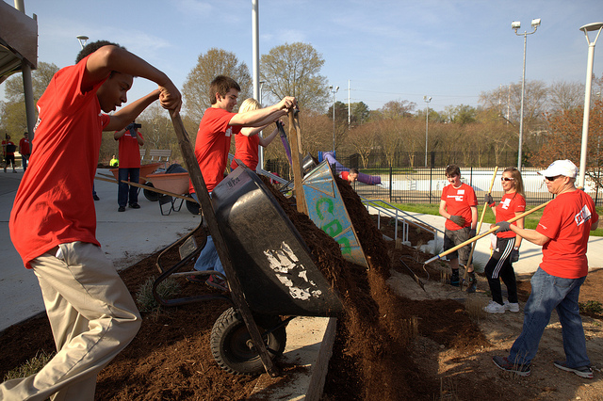
Who Helps?
Prosocial Personality Orientation
Other-oriented empathy
Helpfulness
Notes:
This slide introduces the concept of the prosocial personality.
(Click): Prosocial Personality Orientation
Some researchers have identified the prosocial personality orientation. This personality has two characteristics, one emotional and one behavioral.
(Click): Other-oriented empathy
People with other-oriented empathy feel high amounts of empathy for those in need, and feel a moral obligation to help.
(Click): Helpfulness
People with the helpfulness characteristic have been helpful in the past, think their help is useful, and plan to help in the future.

Slide 14
Overview
Introduction
When do People Help?
Who Helps?
Why Help?
  Evolutionary Roots
  Egoistic Motives
  Altruistic Motives
Conclusion
Notes:
This slide explains the upcoming topic and orients the students.

Slide 15
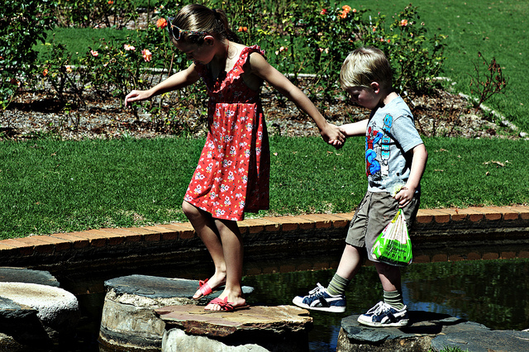
Why Help?
Evolutionary Roots
Kin selection
Reciprocal altruism
Notes:
This slide highlights the evolutionary roots of helping, including kin selection and reciprocal altruism.
(Click): Evolutionary roots
Based on evolutionary psychology, some researchers believe that we help based on the motive to have our DNA – or our family’s DNA – survive in future generations.
(Click): Kin selection
Kin selection is the favoritism shown when helping people who are related to us and share some portion of our DNA.
(Click): Reciprocal altruism
We often help people who are close to us even if they do not share our DNA. Reciprocal altruism is helping people who help us. Evolutionary psychologists state that reciprocal altruism helps our survival, and so it is useful in passing on our genes.

Slide 16
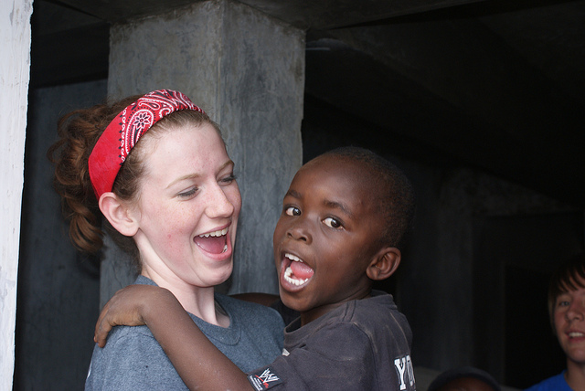
Why Help?
We Are Built to Be Kind
Notes:
The purpose of this slide is to introduce the video, We Are Built to Be Kind.
This is a good time to watch the 4 ½ minute video: We Are Built to Be Kind, which emphasizes evolutionary reasons for why we are compassionate and help others. This is an interview with Dacher Keltner, which emphasizes the evolutionary advantages of helping others, and it is a generally positive, upbeat video, which can be helpful while teaching more negative aspects of human behavior, such as bystander apathy.
https://youtu.be/SsWs6bf7tvI

Slide 17
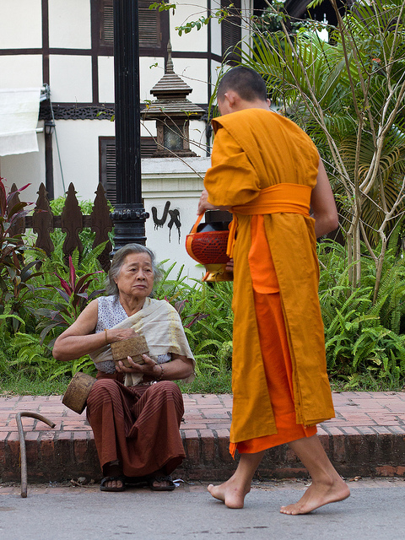
Why Help?
Egoistic Motives
Negative state relief model
Arousal: Cost-reward model
Notes:
This slide highlights the egoistic motives for helping.
(Click): Egoistic motives
Sometimes we help other people not for those individuals but for ourselves. If that’s the case, we have an egoistic motivation for helping. It’s not about the other person; it’s about ourselves.
(Click): Negative state relief model
The negative state relief model states that we help others to make ourselves feel better. For example, when we don’t feel good, helping can boost our mood.
(Click): Arousal: Cost-reward model
The arousal: cost-reward model says that sometimes we help to get rid of the negative emotions (arousal) that occur when we see someone in need. Helping, therefore, reduces our discomfort. This is done within a cost-reward framework.

Slide 18
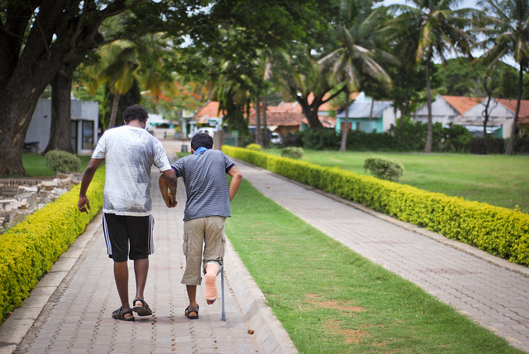
Why Help?
Altruistic Motives
Empathy-Altruism Model
Empathic concern
Or personal distress
Notes:
This slide highlights the altruistic motives for helping.
(Click): Altruistic motives
Rather than focus on egoism as a motivation, this section focuses on altruism as a motivation for helping. Altruistic motivations are focused on helping others as the primary goal.
(Click) Empathy-altruism model
(Click) Empathic concern
The empathy-altruism model states that when we take the perspective of another person, we experience empathic concern, and we are motivated to help by altruistic concerns in order to reduce the other person’s distress. As a result, we may help even if the cost to us is high.
(Click) Or personal distress
The empathy-altruism model also states that when we do not take the perspective of another person, we experience personal distress, and we are motivated by egoistic concerns to reduce our own distress. To reduce our distress, we may help or we may do something easier (low cost), such as leave the situation.
Discussion question: Do you think that we can do things for purely altruistic motives? Or do we always benefit on some level when help others?
This question is designed to get students to think about the differences between altruism and egotism, as well as whether we can tell the difference.
Optional research:
You might want to bring up research that indicates performing random acts of kindness can reduce social anxiety.
An accessible article describing a research study:
http://nymag.com/scienceofus/2015/07/one-way-to-get-over-your-social-anxiety-be-nice.html
And the research study: http://psycnet.apa.org/journals/emo/13/1/64/ (doi: 10.1037/a0027761)
Optional activity: The perspective taking and prosocial activity in the IM – Additional Activities section would fit well here.
In this activity, students get different perspective taking instructions, read a story about a person, and then they rate their empathic concern, psychological closeness, and desire to help similar people. This activity connects perspective taking to empathic concern and prosocial behavior. It would fit well when discussing the empathy-altruism model under altruistic motives.
The description and directions are found here:
Myers, M. W., & Hodges, S. D. (2013). Empathy: Perspective taking and prosocial behavior: Caring for others like we care for the self. Activities for teaching positive psychology: A guide for instructors. (pp. 77-83) American Psychological Association, Washington, DC. doi:10.1037/14042-013

Slide 19
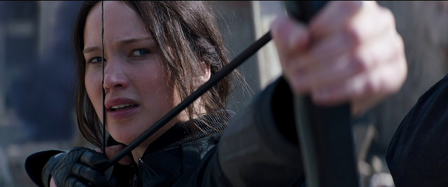
The Hunger Games and Altruism
The Hunger Games Video Clip
Notes:
This slide outlines The Hunger Games and Altruism activity, also explained in the IM – Activities and Demonstrations.
This activity connects the topic of altruism to a movie and storyline lots of students with know (and love), The Hunger Games. Even for students who don’t know the story, the short clip from the movie will give them enough information to answer the questions about altruism, as well as present a concrete example to discuss. The discussion will include the topic of altruism and whether any action can be truly altruistic, and kin selection.
• Time: 15-20 minutes.
• Materials: http://warmupsfollowups.blogspot.com/2013/02/the-hunger-games-altruism.html
The Hunger Games video clip
This link goes to: http://warmupsfollowups.blogspot.com/2013/02/the-hunger-games-altruism.html
The video is 8 ½ minute, but you can stop it after approximately 3 ½ to 4 minutes. This part of the video explains the Hunger Games and includes the part of the movie where Katniss volunteers to take the place of her younger sister, Prim (a.k.a., Primrose).
Discussion Questions:
1) Is Katniss’ decision to volunteer an act of altruism? Why or why not?
This question is designed to get students to think about what altruism is, by having them connect it to a story that is likely familiar to them. The discussion can be directed to focus on the difference between altruism and egoism, and it’s an opportunity for students to make distinctions between the two concepts.
2) Do you think Katniss would have volunteered if it had been an acquaintance who had been chosen?
Students will likely say she would not. If students know the movies or the books, they know that this is not the first time Katniss could have been chosen for the Hunger Games. This is where you can discuss kin selection again.
3) If not, does that make her decision less altruistic?
Altruistic motives are ones that are focused on helping others are their main goal. Since Katniss is volunteering in place of her sister (and hasn’t done so for others in previous years), some students may think it’s not an altruistic motive. The discussion will again get students to think about the difference between altruism and egoism, specifically around the question of whether helping family members is egoistic or altruistic.

Slide 20
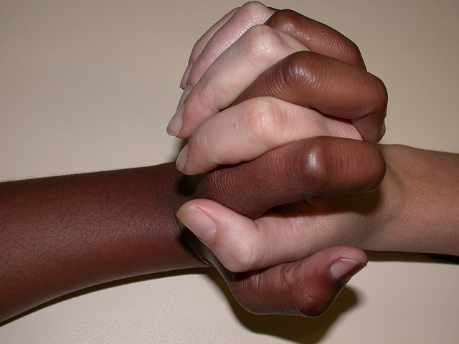
Wrap Up: Conclusion
Notes:
It may be helpful to end the module on a positive note, especially if the material you covered contained a lot of information about how we do not help each other.
You could highlight positive examples from the Carnegie Hero website (http://www.carnegiehero.org/). This is a website with stories of people who have gotten the Carnegie Award, which is given to people who have risked their lives in extraordinary ways to help others. Much the information in this module is how we don’t help others unless we think it benefits us, and that can be distressing for students to learn. Highlighting stories from this website can give other examples of people helping when we would not expect it. You can also stress that we cannot predict exactly when people will help and when they will not (connecting it to research methodology and how to interpret results).
One example from the website:
“Merlin Harn saved a boy from being struck by a train, Menasha, Wisconsin, September 1, 2007. An unattended 3-year-old boy was observed walking on a railroad track by Harn, 40, facilities technician, and his wife as they drove by. They stopped at a crossing near the scene and called authorities. As they waited for police to arrive, the crossing’s lights, bell, and gates were activated, and the whistle of an approaching train sounded. Harn immediately exited his vehicle and, without looking back to the train, ran to the boy, having to cover the 90-foot distance on the ballast of the track bed. Meanwhile, when the 13,000-ton train, which was traveling at about 35 m.p.h., rounded a bend, its locomotive crew saw Harn running and then saw the boy. The engineer immediately engaged the train's emergency brakes. In a continuous motion, Harn grasped the boy under the arms and lunged away from the track with him seconds before the front of the train passed them. Although the train had decelerated, it continued for about a quarter-mile past the scene before stopping.”

Slide 21

CAT: One-Minute Paper
What was the most important thing you learned during this class?
What important question remains unanswered?
Notes:
Classroom Assessment Technique (CAT): One-Minute Paper
If you are presenting the information on one class day, you might end the material about here. End your class time with a one-minute paper.
The One- Minute Paper tests how students are gaining knowledge, or not. The instructor ends class by asking students to write a brief response to the following questions: “What was the most important thing you learned during this class?” and “What important question remains unanswered?”
Have students briefly answer these questions in writing and turn them in. After class, assess students’ responses. At the beginning of the next class, go over any misunderstandings or relevant questions.
If you do not conclude with this Classroom Assessment Technique (CAT), it would helpful to use another CAT. It could be in the form of a:
Muddy point
One-minute paper
Background knowledge
What’s the Principle?
Defining features Matrix:
For more information on CATs click here: http://cft.vanderbilt.edu/guides-sub-pages/cats/

Slide 22
Photo Attribution
Slide 1 | Photo Credit: helping hand Duncan McNeil https://www.flickr.com/photos/duncan_mcneil/863770985/ https://creativecommons.org/licenses/by-nc-nd/2.0/
Slide 3 | Photo Credit: Dorm room University of Denver https://www.flickr.com/photos/uofdenver/5710497637 https://creativecommons.org/licenses/by-nc-sa/2.0/
Slide 5 | Photo Credit: So You Had a Bad Day? Jason Mrachina https://www.flickr.com/photos/40531740@N08/5636870500/ https://creativecommons.org/licenses/by-nc-nd/2.0/
Slide 7 | Photo Credit: Crowd Wayne Large https://www.flickr.com/photos/havovubu/3728604649 https://creativecommons.org/licenses/by-nd/2.0/
Slide 8 | Photo Credit: Long Street crowd, Final Draw, FIFA 2010 World Cup flowcomm https://www.flickr.com/photos/flowcomm/4219250149 https://creativecommons.org/licenses/by/2.0/
Slide 9 | Photo Credit: The kindness of strangers Ed Yourdon https://www.flickr.com/photos/yourdon/3386629036 https://creativecommons.org/licenses/by-nc-sa/2.0/
Slide 11 | Photo Credit: Man Getting into Taxi While Woman Tries to Enter from Other Side WNYC New York Public Radio https://www.flickr.com/photos/wnyc/20389483759/ https://creativecommons.org/licenses/by-nc/2.0/
Slide 12 | Photo Credit: Indian Dancer max_thinks_sees https://www.flickr.com/photos/hundreds/294075361/ https://creativecommons.org/licenses/by-nc-sa/2.0/
Slide 13 | Photo Credit: 2013 North America Kickoff Community Service lenovophotolibrary https://www.flickr.com/photos/lenovophotolibrary/8779805479 https://creativecommons.org/licenses/by-nd/2.0/
Slide 15 | Photo Credit: helping each other out Paul Scott https://www.flickr.com/photos/paulscott56/8632282630 https://creativecommons.org/licenses/by-sa/2.0/
Slide 16 | Photo Credit: DSC02971 NazareneMissionsInternational https://www.flickr.com/photos/84166993@N08/7782347514/ https://creativecommons.org/licenses/by-nc/2.0/
Notes:
Photo Attribution Slide

Slide 23
Photo Attribution
Slide 17 | Photo Credit: Old and Wise Peter Nijenhuis https://www.flickr.com/photos/59446027@N00/6320088058/ https://creativecommons.org/licenses/by-nc-nd/2.0/
Slide 18 | Photo Credit: Friend In Need Harsha K R https://www.flickr.com/photos/mynameisharsha/5832815994 https://creativecommons.org/licenses/by-sa/2.0/
Slide 19 | Photo Credit: 10. Katniss Everdeen - Hunger Games Ansuz Magazine https://www.flickr.com/photos/128277633@N05/15845867908 https://creativecommons.org/licenses/by-nc-sa/2.0/
Slide 20 | Photo Credit: Day 20.06 _ Diversity and Unity Frerieke https://www.flickr.com/photos/frerieke/3644112373 https://creativecommons.org/licenses/by-nc/2.0/
Slide 21 | Photo Credit: Illustrated silhouette of a black cat nehtaeh79 http://www.freestockphotos.biz/stockphoto/16624 http://creativecommons.org/publicdomain/zero/1.0/
Notes:
Photo Attribution Slide

